Slide 1

Hit Song Popularity Prediction
GROUP 13
KAYALVIZHI S U:PPT LEAD
AADITYA CHANDEL:EXECUTION LEAD
MANNAT:VIDEO LEAD
HEMANSHU SAMADHAN BORSE: DOCUMENTATION LEAD
REPO LINK: https://github.com/Aadityaisafk/ai101-team--13-spotify-popularity-predictor

Slide 2

Music popularity can be influenced by several characteristics of a song. Our project
explores the relationship between audio features and popularity and investigates whether
these features can help predict a song's popularity.
IMPORTANT FEATURES:
DANCEABILITY
ENERGY
LOUDNESS
VALENCE
TEMPO
TRACK GENRE
1,14,000
22
114
1,000
TOTAL RECORDS
TOTAL COLUMNS
NUMBER OF GENRES
RECORDS PER GENRE INITIALLY

Slide 3





LIBRARIES USED:
PANDAS
MATPLOTLIB
SEABORN
NUMPY
SCIKIT-LEARN
PATHLIB
Pipeline Diagram
Data Collection
Spotify Track Dataset
Data Preprocessing
Handling missing values
Select features
Exploratory Data Analysis
Visualize popularity
Model Training
Linear regression
Train-test split
Prediction & Evaluation
Predicted popularity
RMSE
MAE

Slide 4
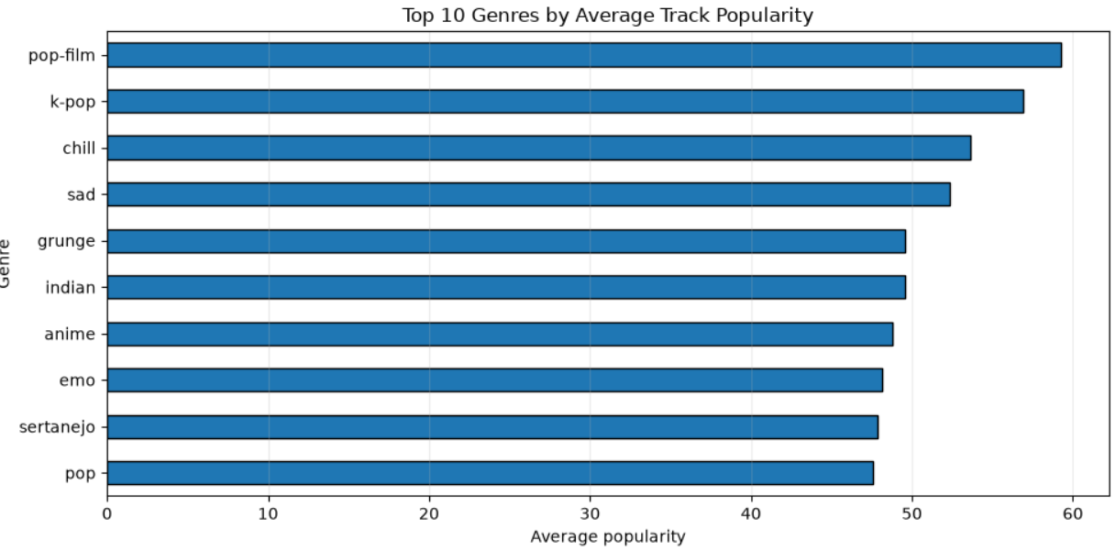
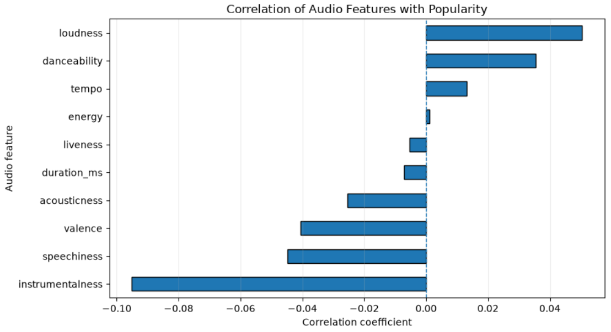
Interpretation of Results
RMSE = 22.044: Indicates the scale of prediction errors.
MAE = 18.39: Predictions differ from actual popularity by 18.39 points on average.
R² = 0.0226: The model explains only about 2.26% of the variation in popularity.
Overall finding: The Linear Regression model was successfully implemented, but its predictive performance was limited.
RMSE
22.044
R2 SQUARE
0.0226
MAE
18.39

Slide 5

WHAT WORKED: Successful implementation of the data preprocessing, visualization and model-training pipeline.
WHAT DIDN’T WORK: The model's prediction errors remained higher than expected.
ROLES:
AADITYA CHANDEL
(EXECUTION LEAD): Create and maintain the GitHub repository.
Ensure all code modules work together.
Fix integration and execution errors(CODE)
HEMANSHU SAMADHAN BORSE
(DOCUMENTATION LEAD): Create and maintain the GitHub repository.
Prepare the README.md file.
Data cleaning and preprocessing.(CODE)
MANNAT(VIDEO LEAD):Plan the video of maximum 7 minutes.
Explain the problem and methodology.
Linear Regression model training and predictions.(CODE)
KAYALVIZHI S U(PPT LEAD):Prepare exactly 5 PPT slides.
Explain the problem statement and dataset.
Exploratory Data Analysis & Graphs.(CODE)
DISCLOSURE:
Models used: ChatGPT,claude and Gemini.
Used for: Assisting with matplotlib diagnostic plot formatting, debugging import paths, and drafting initial documentation structure.
Verification: All mathematical logic, preprocessing steps, feature scaling, and model evaluations were tested and verified locally by the team.

